Slide 1
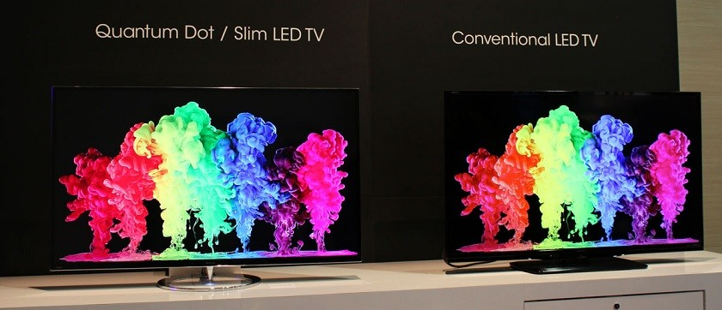
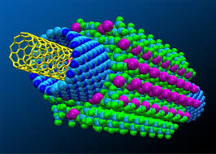
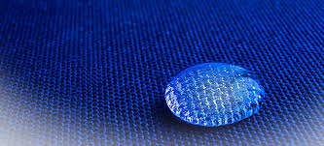
Nano technology
VIT University, Bhopal
Course Name: PH
Nano tech Video

Slide 2
Lecture 1

Slide 3
Learning objectives
Introduction to nano material Moors law What is nano material How to make nano materials Quantum Confinement | What is CNT How to make CNT Properties of CNT Application of CNT
Lecture 1 | Lecture 2

Slide 4
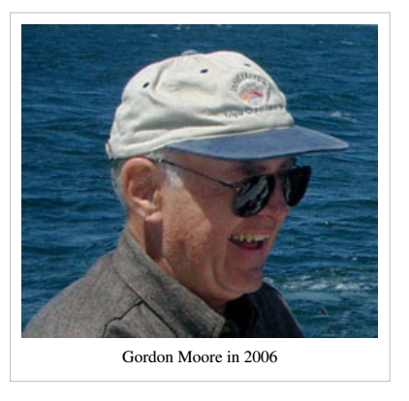
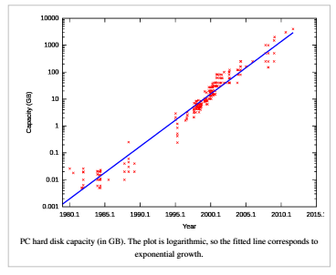
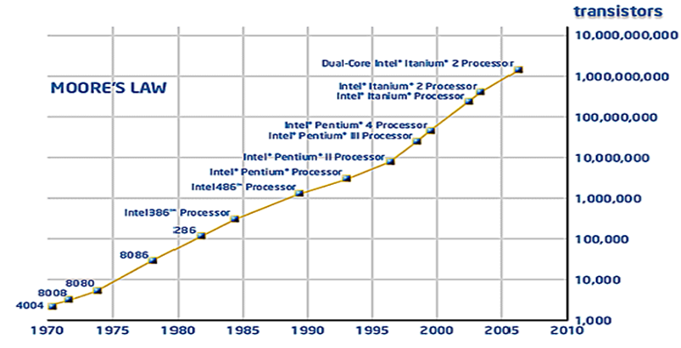
Moore’s law
The number of transistor in an integrated circuit doubles in every 18 or 24 months
Size of the transistor will be reduced
Source : Internet

Slide 5
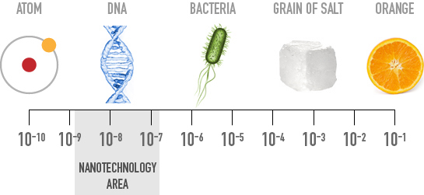
What are nano materials
NANO from Greek word “NANOS” means Dwarf

Slide 6
Nano materials
At least one spatial dimension is in the range of 1 to 100 nm
  Thus the material need not be so small that it cannot be seen, it can be a large surface or a long wire whose thickness is in the scale of Nanometers.

Slide 7
Why nano materials
Property changes at nano scale
  Quantum confinement effect
  Increased surface area

Slide 8

How to make nano materials
Bottom up approach
    In this case molecular components arrange themselves into more complex assemblies atom-by-atom, molecule-by-molecule, cluster-bycluster from the bottom (e.g., growth of a crystal)
Activity:
Silver nano particle synthesis

Slide 9
Top down approach
    Nano scale devices are created by using larger,
    externally-controlled devices to direct their assembly
Example: Photolithography
Si substrate
After Etching
After Etching
Ruling technique in IC preparation
Trade off’s
Too many steps to prepare micro and nano fabricated system
limitation in high resolution

Slide 11
Properties:
Optical Properties: Different for different materials
Metals: Due to surface plasmons
Semiconductors: Due to Band Gap
Quantum Confinement
Electrical Properties
Magnetic Properties

Slide 12
Quantum confinement
In nano material the electronic energy levels are discrete unlike bulk material, where the energy level is continuous. Energy level is discrete due to confinement of the electronic wave function in restricted physical boundary.

Slide 13
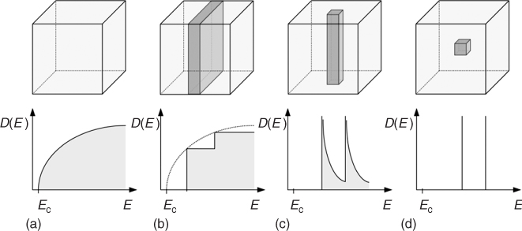
Quantum confinement
Three kinds of confinement
    0 dimension –Quantum dot
    1 dimensional – Quantum wire
    2 dimensional restriction – Quantum wells
What will happen to the energy level after quantization
Confinement
DOS
The physics and engineering of compact Quantum Dot-based Laser for Biophotonics

Slide 14
Quantum Confinement
Definition:
Quantum Confinement is the spatial confinement of electron-hole pairs (excitons) in one or more dimensions within a material.
1D confinement: Quantum Wells
2D confinement: Quantum Wire
3D confinement: Quantum Dot
Quantum confinement is more prominent in semiconductors because they have an energy gap in their electronic band structure.
Metals do not have a bandgap, so quantum size effects are less prevalent. Quantum confinement is only observed at dimensions below 2 nm.

Slide 15
Electrons confined in one direction, i.e., quantum wells (thin films): Electrons can easily move in two dimensions (2D), so one dimensional is quantized. Electrons confined in two directions, i.e., quantum wires: Electrons can easily move in one dimension (1D), so two dimensional is quantized.
3D Confinement (0D restriction)-Quantum Dot
2D Confinement (1D restriction)-Quantum Wire
1 D confinement ( 2d restriction) –Quantum well

Slide 16
Recall that when atoms are brought together in a bulk material the number of energy states increases substantially to form nearly continuous bands of states.
Energy
Energy
N

Slide 17
Quantum Dots
Nanocrystals (2-10 nm) of semiconductor compounds
Small size leads to confinement of excitons (electron-hole pairs)
Quantized energy levels and altered relaxation dynamics
Examples: CdSe, PbSe, PbTe, InP

Slide 18
Quantum Dot (QD)
Quantum Dot’s are Nano scale semiconductor crystal , where motion of
electron are restrain in all three dimension.
Photovoltaic
Non linear optical effects
Emitted light colour depends upon size of QD
QD
Biological levels
Drugs
Photocatalysict
Photo and electrochemical devices
QD LCD Display
By samsung
Activity:
What will happen to absorbance
spectra if the diameter of QD changes
Bio conjugates
Example of QD: PbS, GaAs, CdS

Slide 19
Quantum Wire
Quantum wire are nano crystal where the electronic motion is restricted in only one direction
So basically a tiny wire having diameter of nano meter range
Example: nanotube
Applications
Sensors
Electrodes
Capacitors
Membranes

Slide 20
Quantum well
Quantum well are nano crystal where motion of electron is restrain in two dimension
Conduction band
Quantum well
Valance band

Slide 21
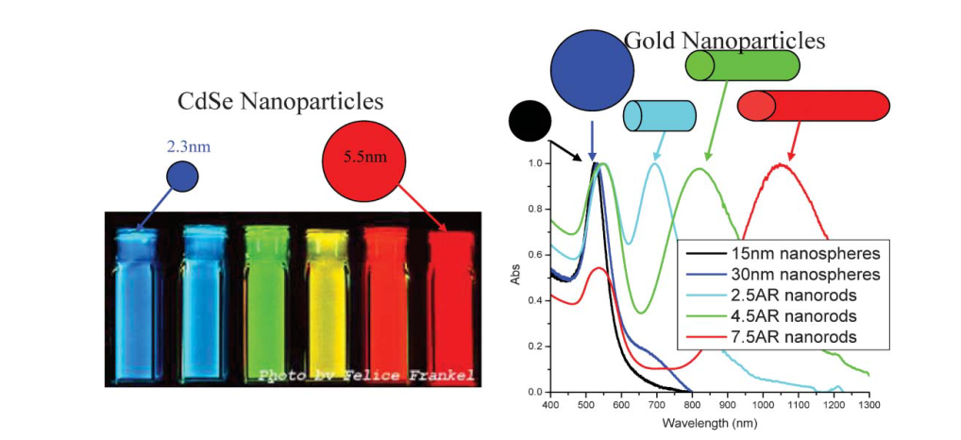

Slide 22
Lecture 2

Slide 23
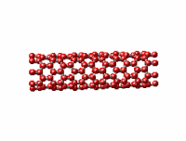
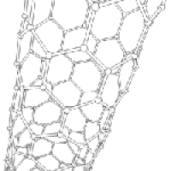
Carbon nano tube

Slide 24
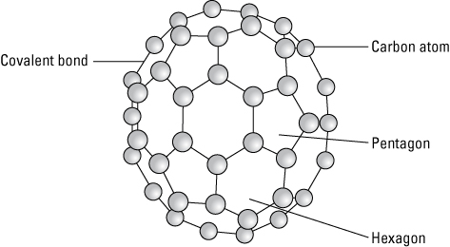
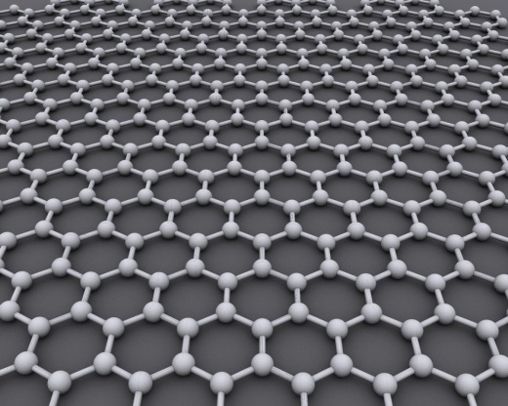
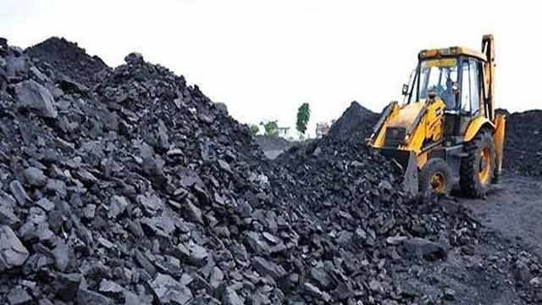
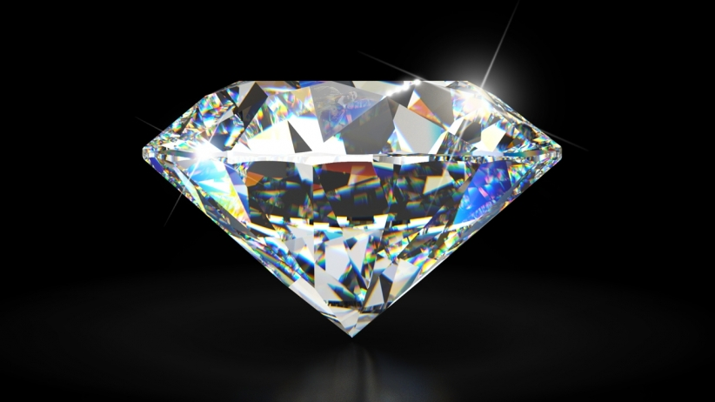
Allotropes of carbon

Slide 25

Reason – Hybridization
Property
SP³ hybridization
Insulating
Shape of orbital and there overlapping changes with the hybridization
SP² hybridization
Conducting / semiconducting

Slide 26
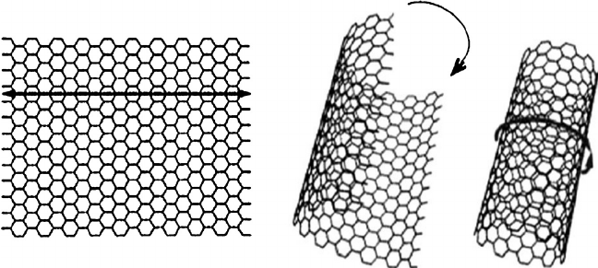
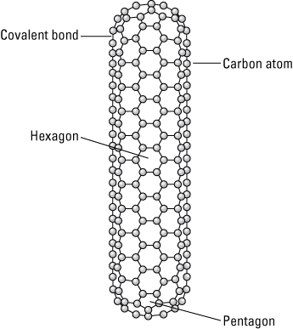
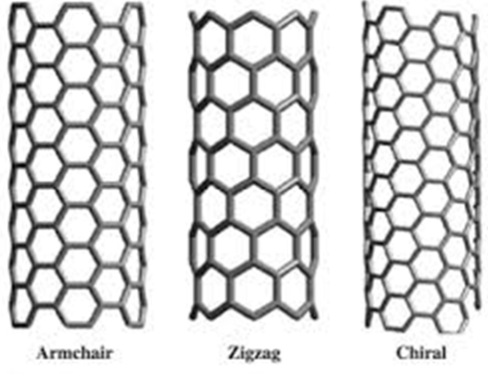
CNT structure
As if you are rolling a Graphene sheet
Actual CNT preparation method is different
http://www.understandingnano.com/
http://www.robaid.com
www.researchgate_net-92862_fig1_Fig-1-Rolling-up-of-graphene-sheet-to-form-carbon-nanotubes

Slide 27
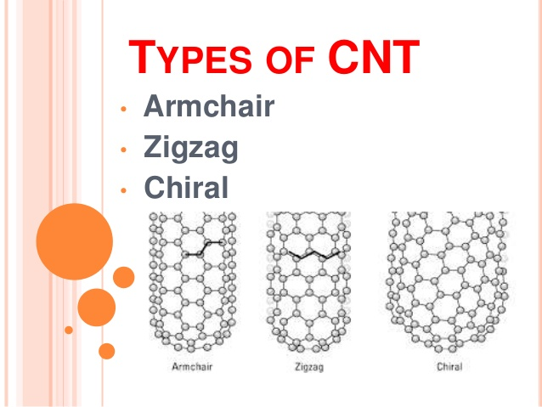

Slide 28
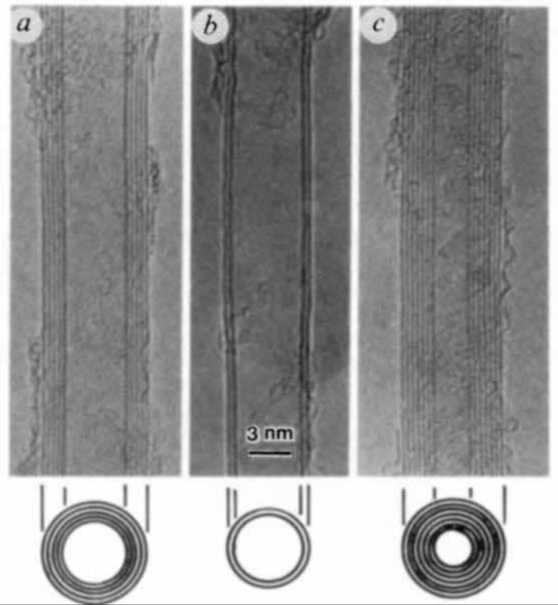
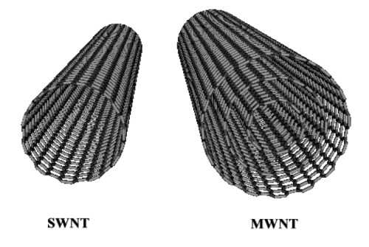
Different CNT
www.nanoshel.com

Slide 29
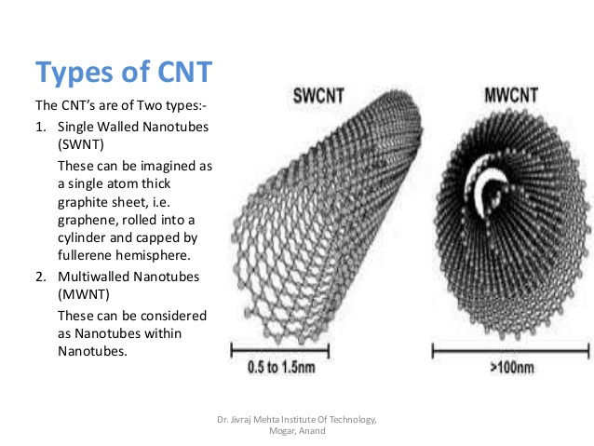

Slide 30
Different process to make CNT
Arc discharge
Main difficulty :
separation of MWCNT / SWCNT from impurity is difficult
Chemical vapour deposition (CVD)
Most promising technique for industry use
Laser ablation

Slide 31
CNT properties
Electrical property
nanotube shows both metallic (arm chair ) and semiconducting (chiral) property
depending on the diameter and chirality
band gap decrease with increasing diameter
less defects to scatter electron , hence low resistivity. (metallic nanotubes can carry
an electrical current density of 4×10⁹ A/cm² which is more than 1,000 times greater
  than metals such as copper)
Mechanical property
highly resilient (high young’s modulous)
if bended, almost hexagonal carbon rings changes in structure but don’t break
reason – SP² hybridization
High thermal conductivity

Slide 32
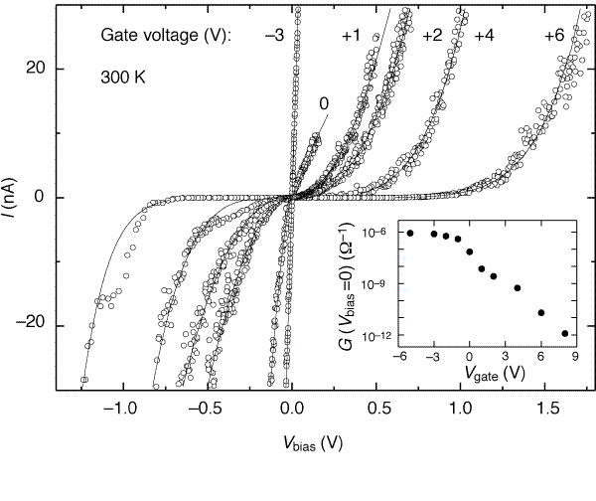
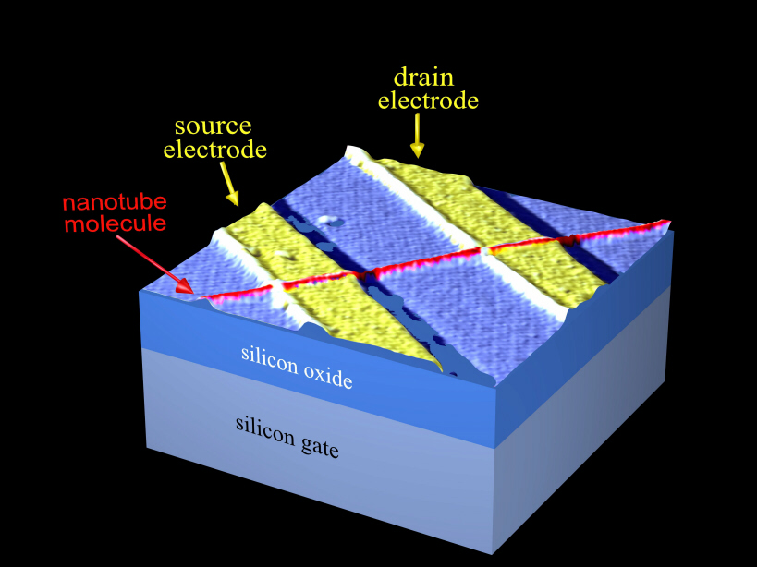
CNT application
Single electron transistor
  Use lithography to make it
  Small size allows more switch's to be packed on a chip
  Switching time is fast, 10⁴ times faster then present system
Tans et al, Room-temperature transistor based on a single carbon nanotube, Nature 393

Slide 33
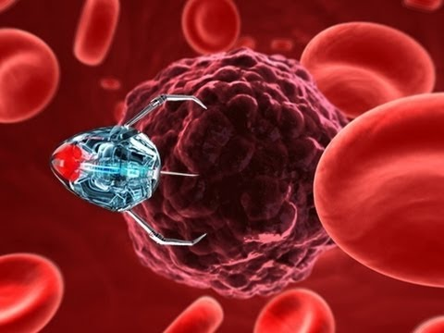
Quantum computing
Energy technology
  CNT can be used to improve the efficiency of the conventional Li ion battery
      High surface area
      Good electrical conductivity
      Linear geometry
  Medical sector
  Drug delivery, cancer treatment, Tissue regeneration
  Actuators

